Slide 1
Sales-Predicition Project
By: Reagan L. Tiburan

Slide 2
This project will be a sales prediction for food items sold at various stores. The goal of this is to help the retailer understand the properties of products and outlets that play crucial roles in predicting sales.
Project Description

Slide 3
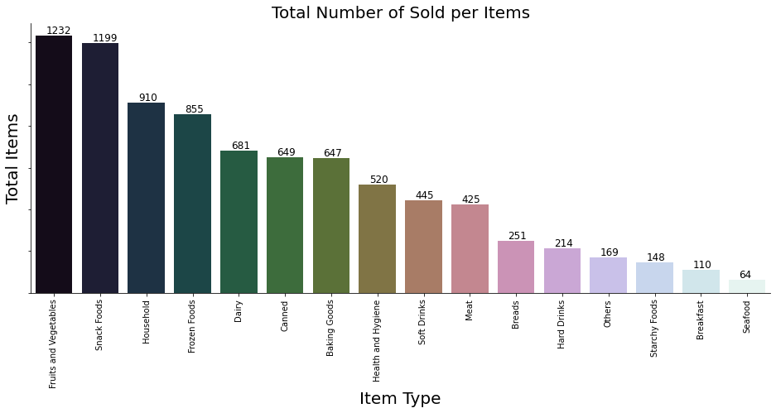
The graph below illustrates the total number of Sold per Item, We can see that Fruit and Vegetables are the most bought product, followed by Snack Foods, Household, Frozen Foods and Diary.

Slide 4
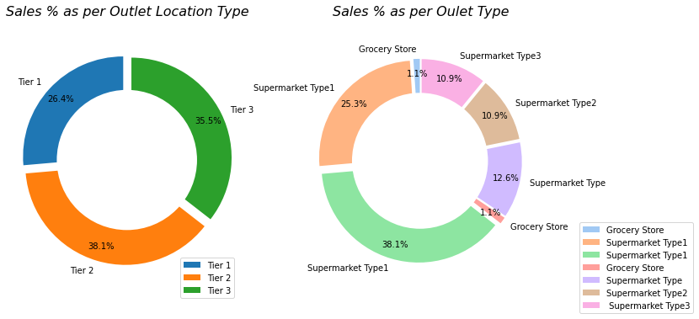
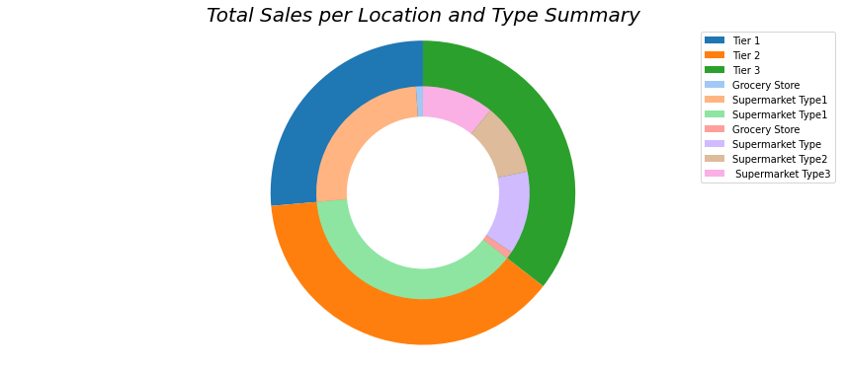
The donut chart below gives us a visualization on which Outlet Location Type and Outlet Type has the most Outlet Sales. We can see from the chart that “Tier 2” outlet location and “Supermarket Type 1” outlet type has the most sales output. While “Tier 1” location type and “Grocery Store” outlet type has the least sales.

Slide 5


Machine Learning Models
For Machine Learning Models we tried 2 different models to test our Dataset and see which will provide the better result.
1. Linear Regression Model
- based on the score result, our dataset is not fit for this model due to high error on its test result.
2. Decision Tree Regression Model
- the result of this model is better than Linear Regression, we can see that we have result of train and test difference are not so big.

Slide 6
Model Recommendation
From the result of the two Models, we can recommend that the best Model for our dataset would be the Decision Tree Regression Model. It provides better score result during our Model test.

